Slide 1
PERFORMANCE
PIQUE

Slide 2
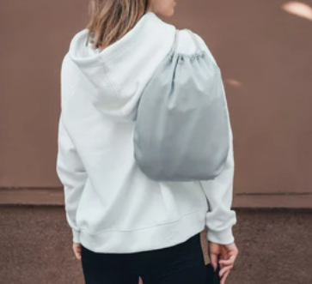
Performance Pique’s soft, stretchy composition is perfect for moisture-wicking athletic apparel such as tennis dresses, yoga tops etc., offering a soil-release finish for enhanced laundering.
Wrinkle-resistant and easy to
pack in a small bag.

Slide 3
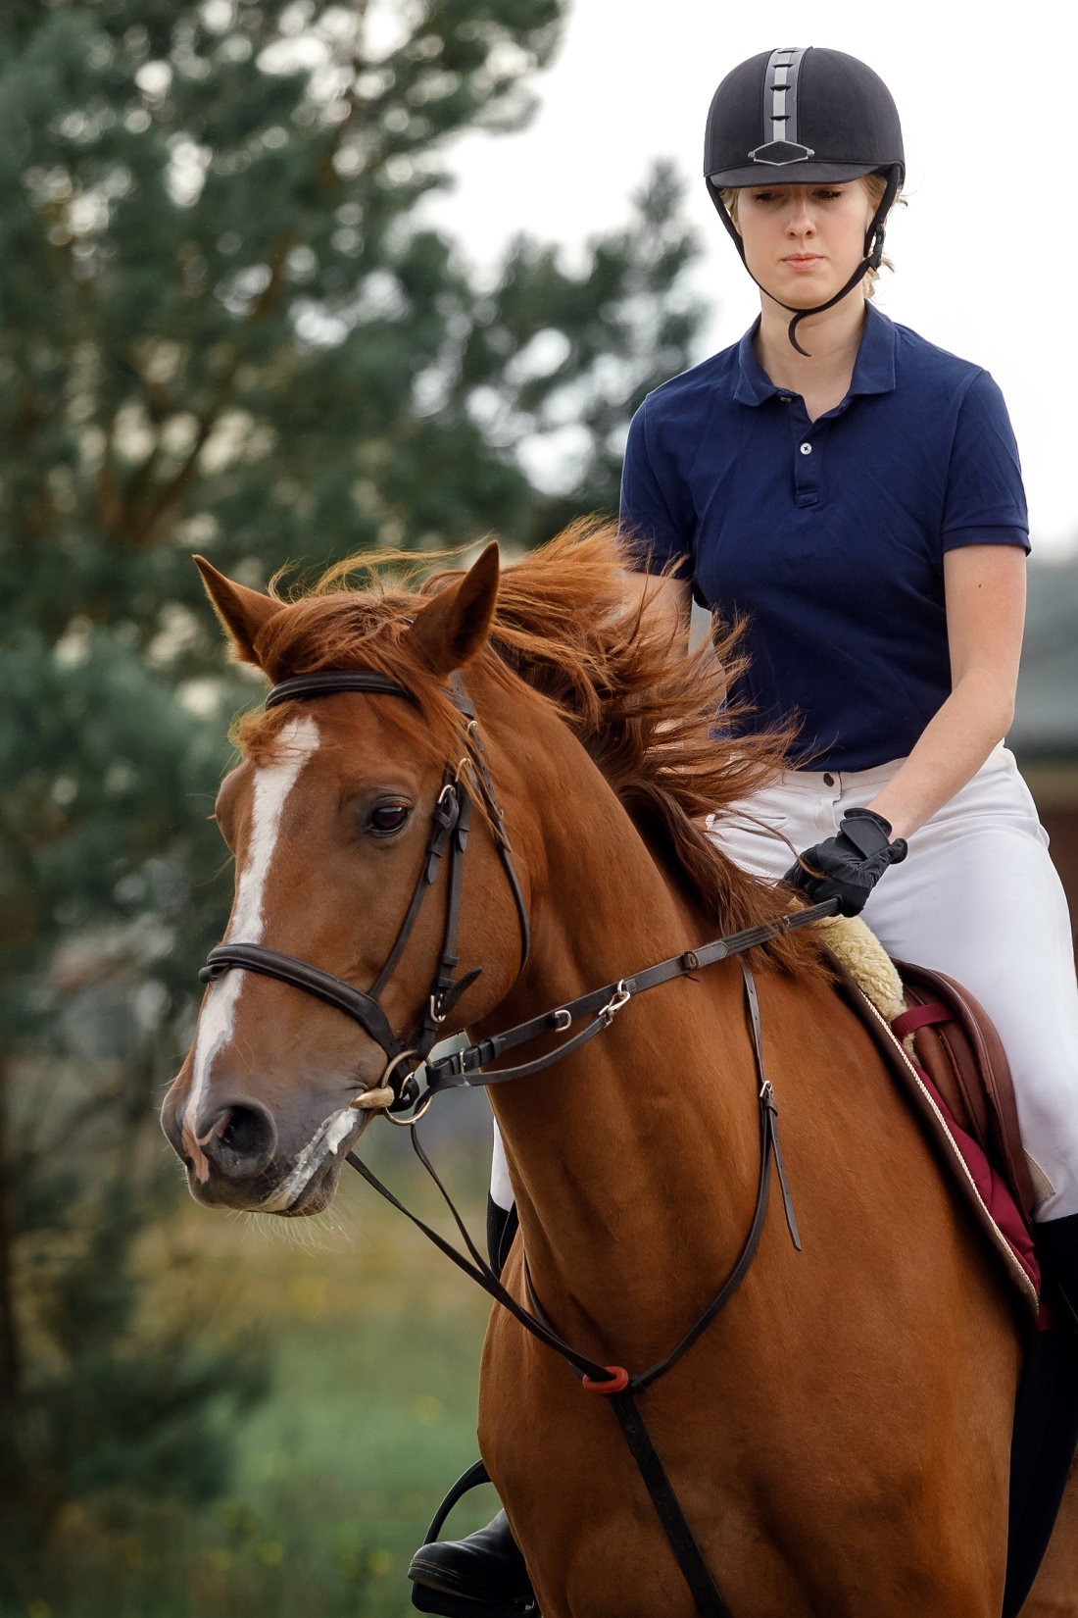
STRONG WASH DURABILITY
COMFORTABLE
LIGHTWEIGHT

Slide 4
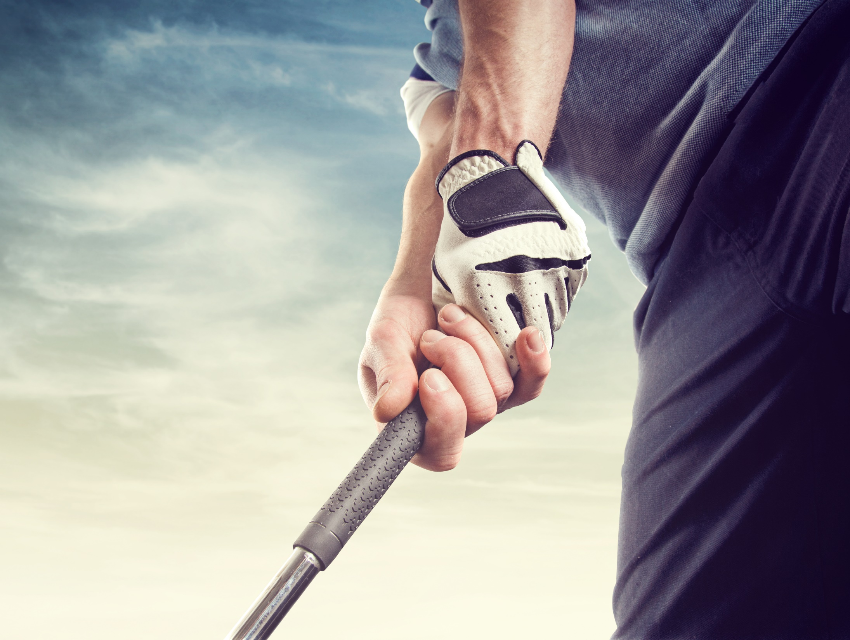
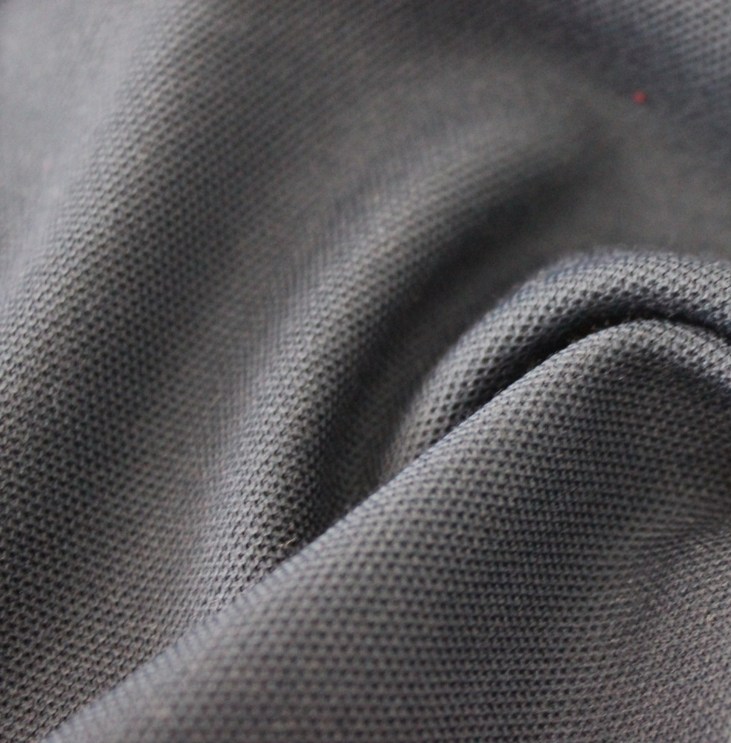
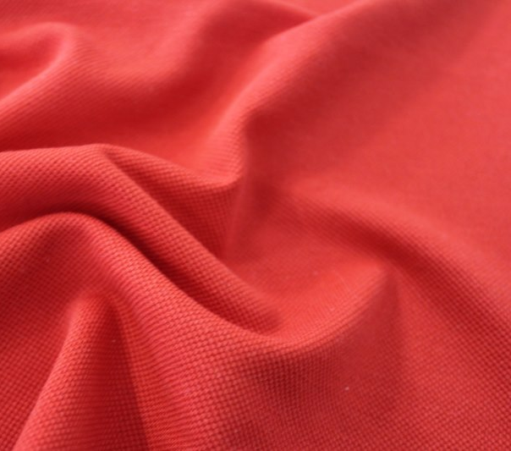
DURABLE
W2071
Pique
50%CO50%PES
Weight: 210 gr
Width: 190 cm
W9013
Pique Interlock
53%CO47%PES
Weight: 185 gr
Width: 196 cm

Slide 5
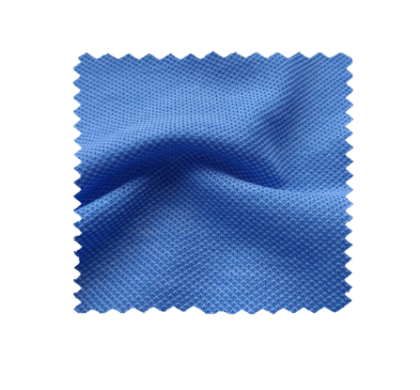
NATURAL TOUCH
E20244-001
Pique
100%CO
Weight: 150 gr
Width: 198 cm

Slide 6
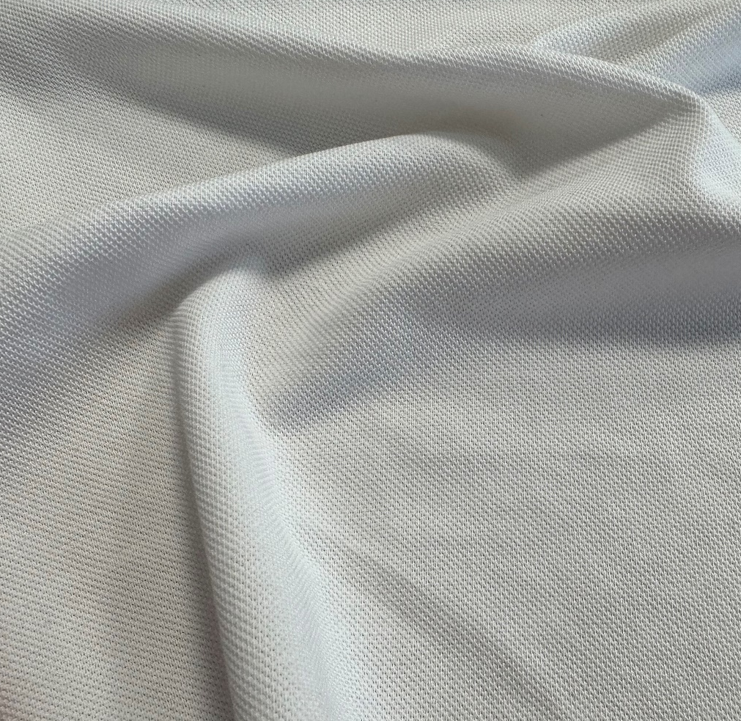
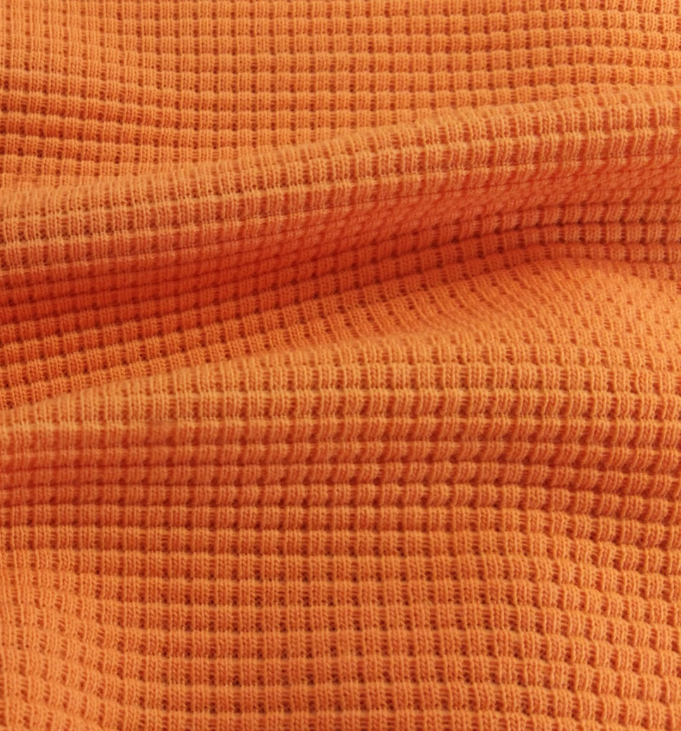
E73505-001
Structured Reported Ribana
64%TEN36%CO
Weight: 190 gr
Width: 160 cm
E20364-002
Pique
56%CO44%PA
Weight: 180 gr
Width: 165 cm
E94382-001
Reported Ottoman
52%RCYPES48%ORGCO
Weight: 210 gr
Width: 194 cm

Slide 7
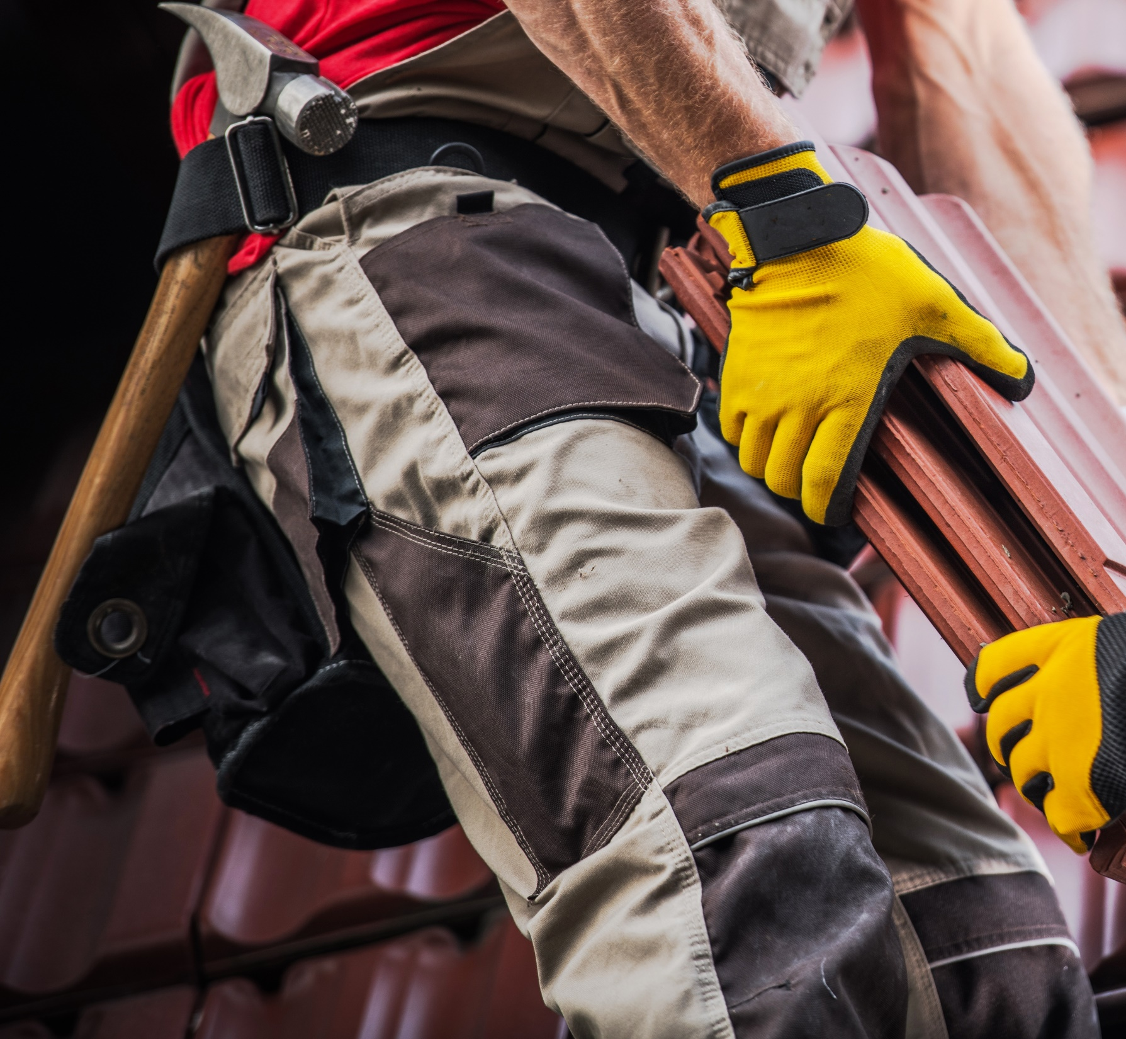
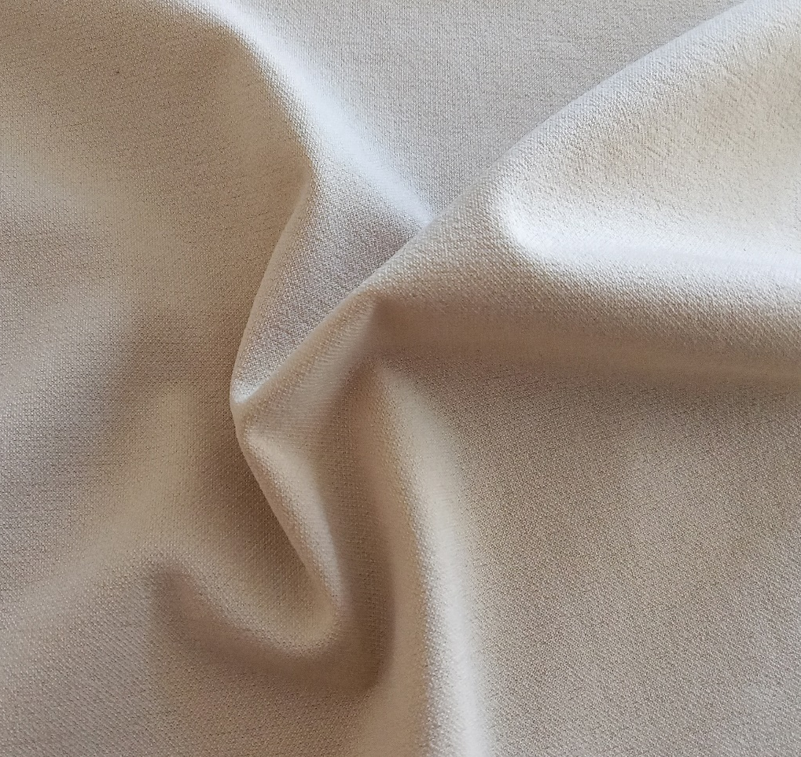
SORONA
SERIES
E93838-001
Pique Interlock
78%ELASTOMULTIESTE22%PES
Weight: 190 gr
Width: 144 cm

Slide 8
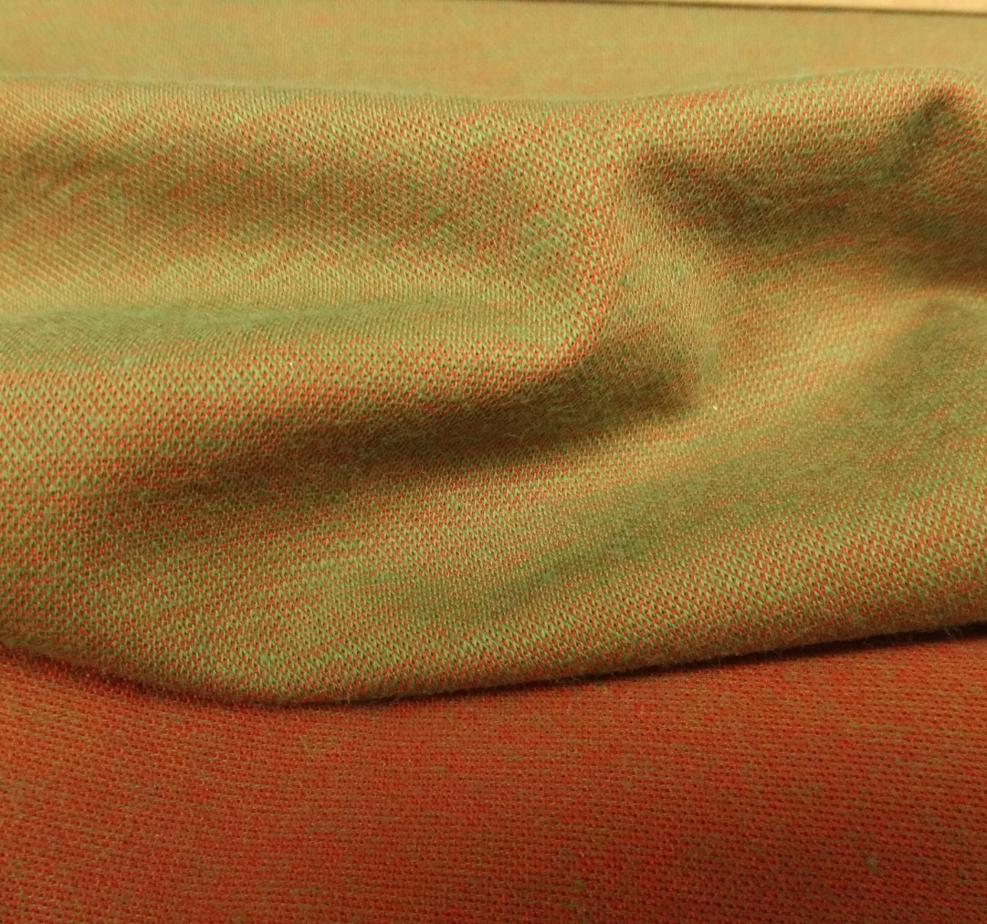
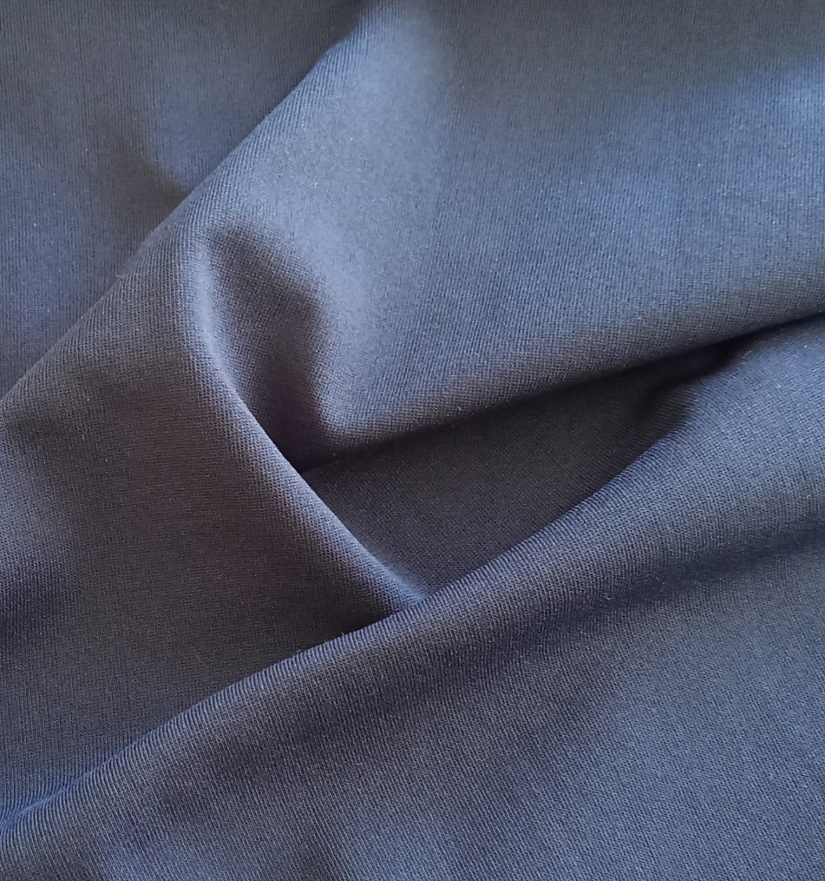
E02761-001
Reported Pique Single Jersey
52%ELASTOMULTIESTE48%CO
Weight: 165 gr
Width: 125 cm
E10393-001
Plated Single Jersey
61%ELASTOMULTIESTE39%PES
Weight: 140 gr
Width: 150 cm
E03977-001
Reported Pique Single Jersey
51%CO49%ELASTOMULTIESTER
Weight: 190 gr
Width: 125 cm

Slide 9
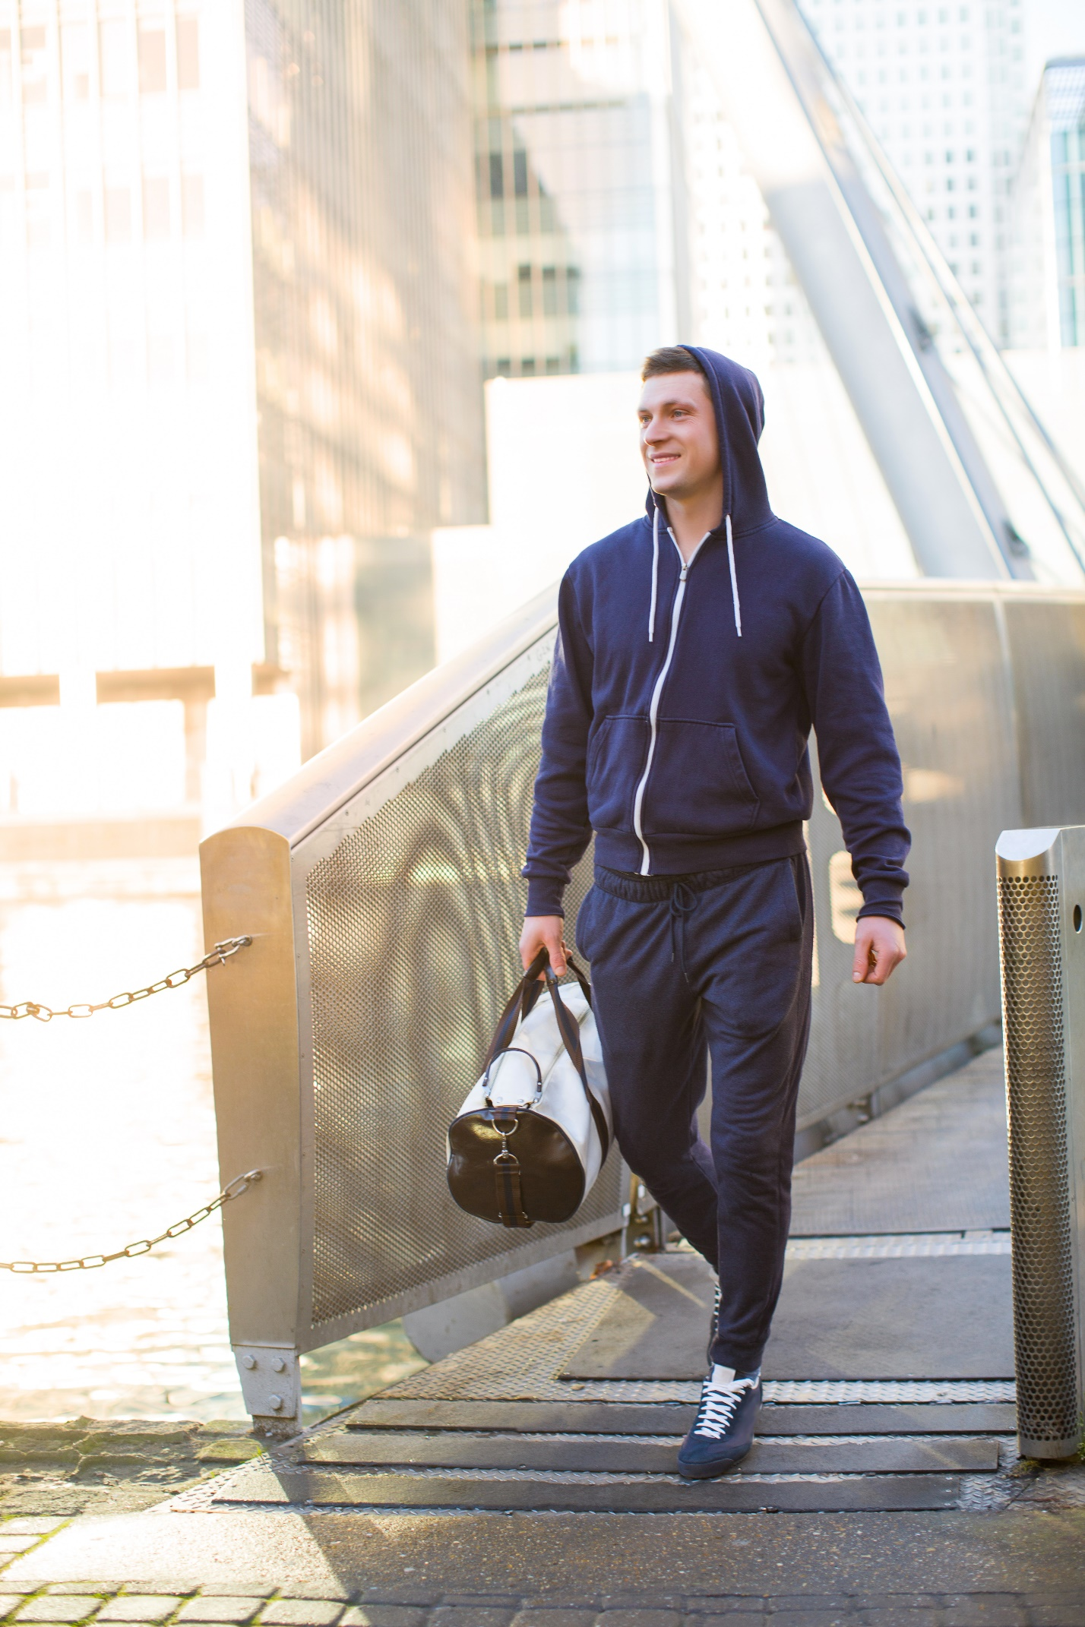
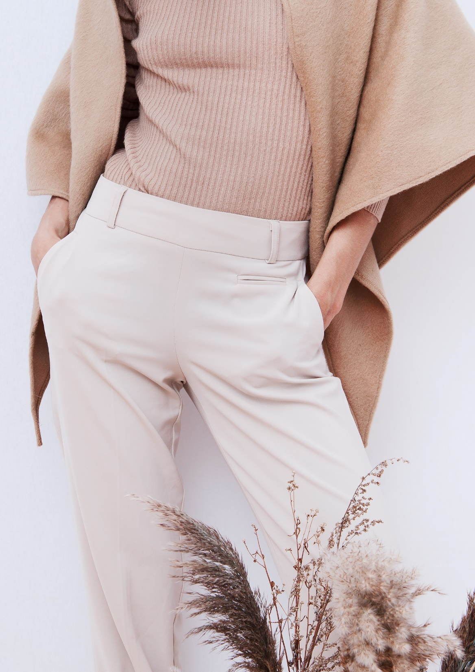
COMFORT SERIES

Slide 10
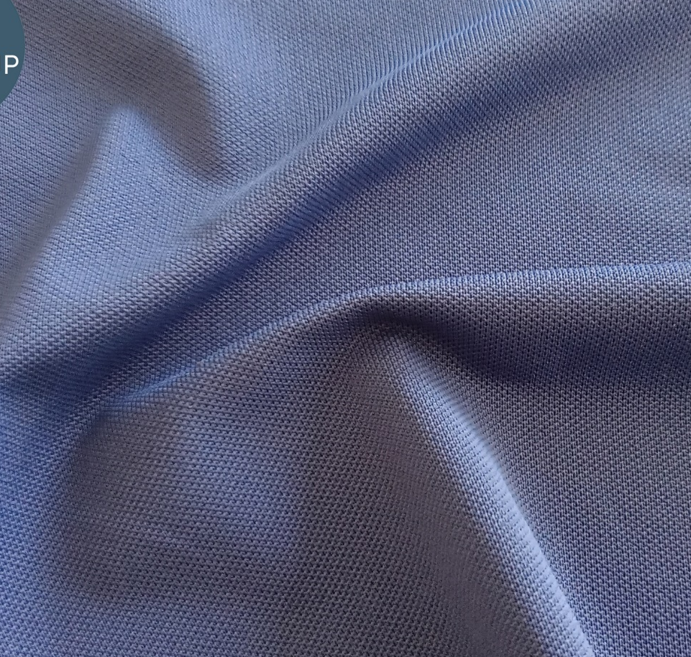
E20369-001
Pique
96%PA4%EA
Weight: 190 gr
Width: 207 cm
E20386-001
Pique
95%PA5%EA
Weight: 220 gr
Width: 164 cm
E20407-002
Pique
100%PES
Weight: 170 gr
Width: 172 cm

Slide 11
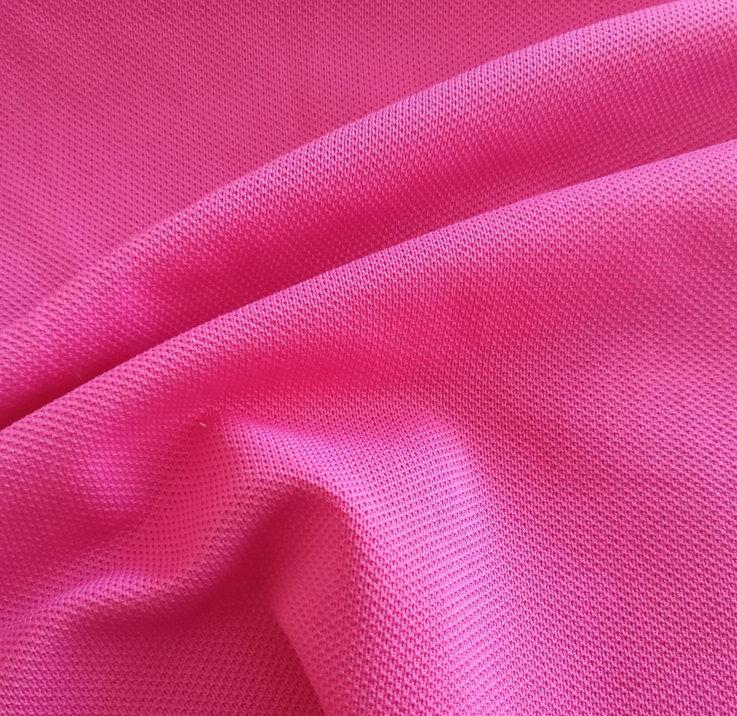
E20392-003
Pique
96%PA4%EA
Weight: 210 gr
Width: 184 cm
E20383-001
Pique
92%PA8%EA
Weight: 240 gr
Width: 150 cm
E20381-001
Pique
94%PA6%EA
Weight: 200 gr
Width: 172 cm

